Slide 1

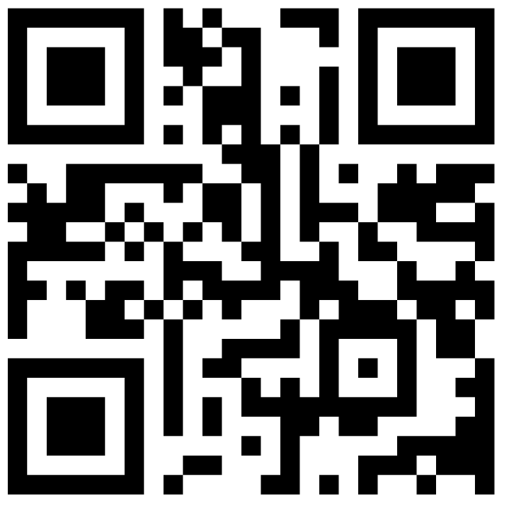

Slide 2

Who we are
800+ Members Strong: Connecting Austin’s tech, creative, and business leaders passionate about AI.
50 Active Attendees per Meeting: A mix of local innovators, enthusiasts, and early adopters.
Supportive & Engaged Community: A well-balanced Discord that’s "useful, but not overwhelming."

Slide 3
Monthly Showcases, Labs & Mixer 🍻🎉
Main Event: Every month, we meet at ACC’s historic Rio Grande Campus.
Agenda Highlights: Demos, labs, panels, and then we unwind with an after-party.
Next Meeting: Wednesday, November 13th, 6 PM
After Hours: Two weeks later, we host mid-month happy hours at fun Austin spots—next one’s at Kinda Tropical!

Slide 4
Where to Connect & Stay Updated 📲
Website: aimug.org – All things LangChain and AIMUG.
Discord: Join us for ongoing conversations.
GitHub: Austin LangChain Repo – Check out our open-source projects.
Meetup: Austin LangChain Group
Twitter: @AustinLangChain – Latest updates and AI news.
YouTube: Austin LangChain Channel – Watch replays and tutorials.

Slide 5
AIMUG Events & Activities 🌟📅
Monthly Showcases & Mixer: Community members share projects and demos; labs for hands-on learning.
Hacky Hours (Mid-Month): Informal happy hours at local spots; meet, discuss, and relax.
Weekly Virtual Syncs: Tuesdays & Thursdays at 2 PM – Workshopping, problem-solving, and AI discussions.

Slide 6
A Welcoming Culture of Learning & Growth 🤝🌱
Low-Stress, Collaborative Environment: We welcome questions, ideas, and collaboration.
Connect with AI Enthusiasts & Early Adopters: Find mentors, partners, or friends who share a passion for AI.
Our Motto: Learn, Share, Grow – Together, we’re advancing the AI landscape.

Slide 7
Code of Conduct – "Be Cool to Each Other" ✌️
Respect & Inclusivity: Our only rule is simple: “Be cool to each other, don’t be gross.”
AI Enthusiasts of All Levels Welcome: We celebrate diverse perspectives and unique paths in AI.

Slide 8
